Slide 1
Advanced Java Concurrent Patterns
COURSE OVERVIEW

Slide 2
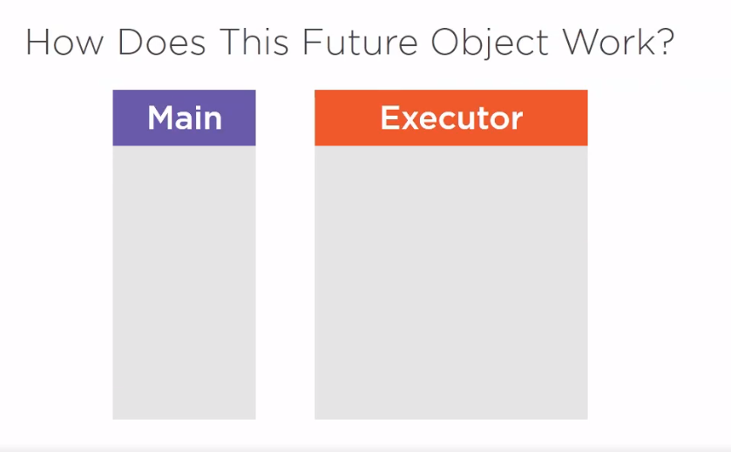

Slide 3
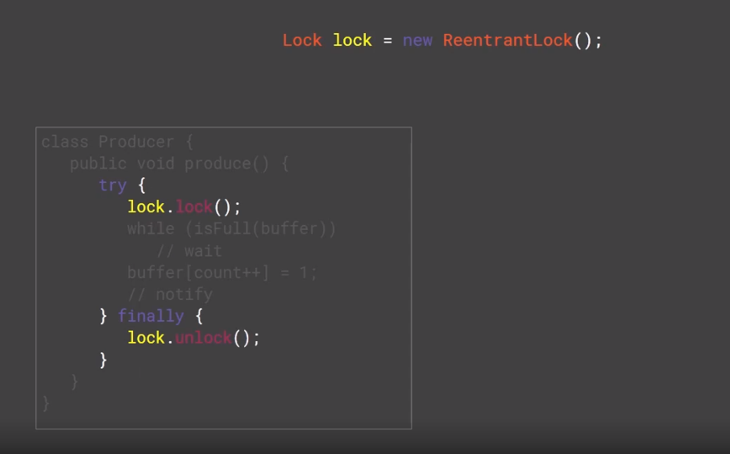

Slide 4
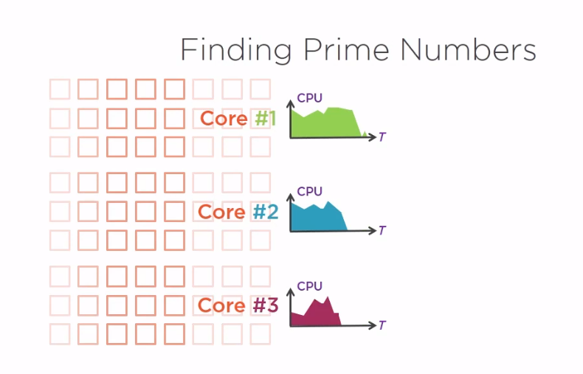

Slide 6
